Slide 1
Pseudohomophones
Building the experiment in PsychoPy

Slide 2
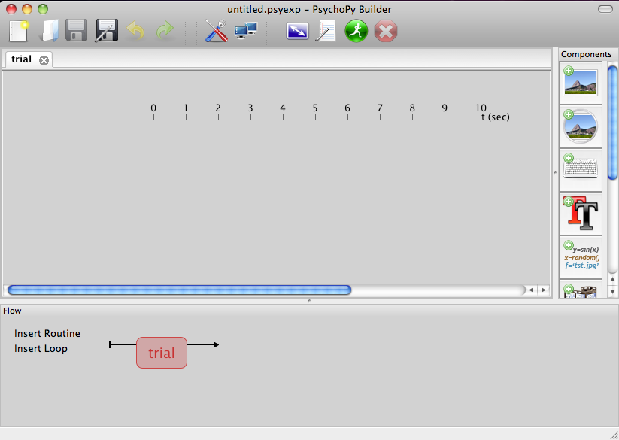


Getting started in PsychoPy
Open PsychoPy and go to the Builder view
If you have an experiment already open create a new one
Save it straight away to a (new?) empty folder somewhere. Add the conditions files to this folder.

Slide 3
Better precision
In this study we will be more precise about our stimuli
Set the size of our letters based on “degrees of visual angle”
Set the duration of our probe stimuli by “number of video frames”

Slide 4
Using ‘degrees’ for our stimuli
We want to report the size of our stimuli, as seen by the participant, so that the study can be replicated
A subject viewing a really large stimulus at a long viewing distance is generally equivalent to them seeing a small stimulus at a short distance (it has the same image on the retina)
Usually people report stimulus size/location in terms of the “visual angle” that it makes at the retina. This is independent of the display size/distance
angle

Slide 5
Translating cm -> degrees
We could calculate the size of our stimuli in degrees using trigonometry:
angle = tan⁻¹(sizeCm / distanceCm)
at 57cm a 1cm stimulus has a visual angle of 1°
at 114cm a 1cm stimulus has a visual angle of 0.5°
Or we could let PsychoPy do that for us
Notes:
NB the above calculations are approximate – they assume the screen is curved so all parts are equidistant from the eye

Slide 6

Using degrees as units in PsychoPy
PsychoPy needs to know about your monitor.
Go to Tools>Monitor Center.
For the testMonitor set the
Width of the screen (cm)
Size of the screen (pixels)
Distance to the screen (cm)
In your experiment settings make sure that the monitor is set to use testMonitor too
Set the units for this experiment to ‘deg’
Now be careful about the size/position of your stimuli (0.1 was sensible as a fraction of the screen but it’s tiny in degrees!)

Slide 7
Specifying time using frames
Your monitor only updates periodically (on nearly all LCD screens this is at 60 Hz, ie 60 frames per second)
So the length of one ‘frame’ on an LCD is 1/60s = 16.6666ms
Stimuli will always be presented for exact multiples of this value
You cannot have a stimulus appear for 160ms, only 150ms (9 frames) or 166ms (10 frames)
For very precise timing (e.g. for brief stimuli) it is better to specify your stimulus onset/duration in frames so that you get exactly what you want
For long durations this might not be so important

Slide 8
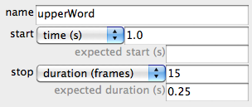
Frames in PsychoPy
In PsychoPy you can specify start/stop times using frames
The stimulus below will appear at (roughly) 1.0s and last exactly 250ms on a 60Hz display
1 frame=1/60s (=16.66ms)
15 frames=15/60=0.25s (=250ms)
Expected duration is just to let PsychoPy know how to represent the stimulus on the timeline – it has no effect on the actual stimulus

Slide 9
Define one trial
We need to set up a trial with;
a fixation (we could use a ‘+’) for 3s
a word that appears above fixation for 0.5s
a word that appears below fixation for 0.5s
a response from the participant, that will terminate the trial

Slide 10

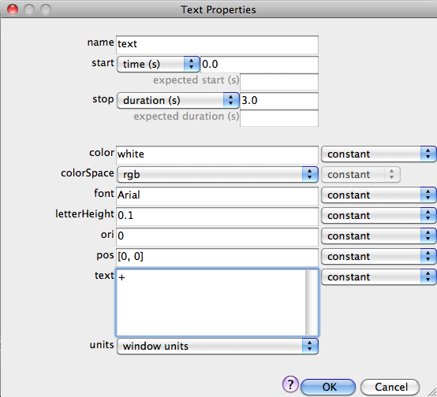
Create the fixation
Add a text component
Set it to start at t = 0 (s)
Duration = 3.0 (s)
Text = +

Slide 11
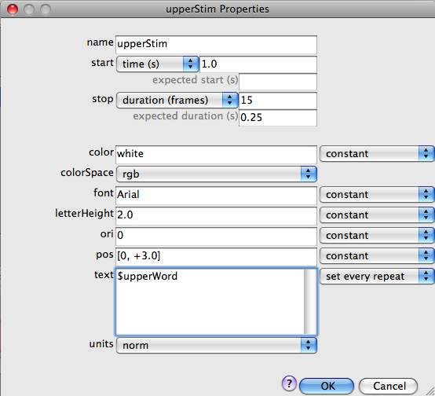
Create the upper word
Name = upperStim
Set to start at t = 1.0 (s)
Duration = 15 frames
(more accurate than setting seconds for brief stimuli)
Text = $upperWord
(this will come from our conditions file in Excel)

Slide 12
Create the lower word
Repeat as for upperStim, but set pos to be
pos = [0,-5] i.e. 5 deg below the fixation point
name = lowerStim
text = $lowerWord parameter from the conditions
Note that the name of the stimulus (lowerStim) was not the same as the name of the parameter (lowerWord) in the conditions file. Everything must have a unique name!

Slide 13
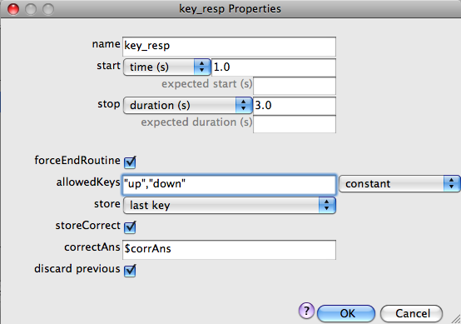
Collect a response
Now we need a Keyboard Component to collect the participant’s response
Start at the same time as the words and last for 3s
Must match the name of the param in Conditions file

Slide 14
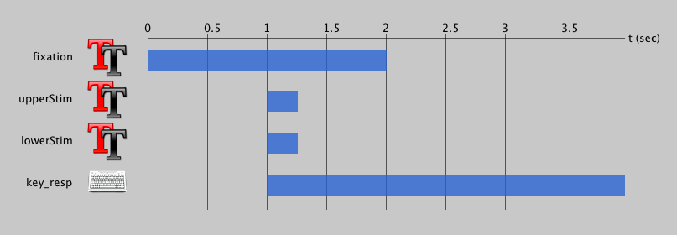
Trial overview
Your trial Routine should now look like this:

Slide 15
Define some conditions
Open Excel and create the following table:

Slide 16
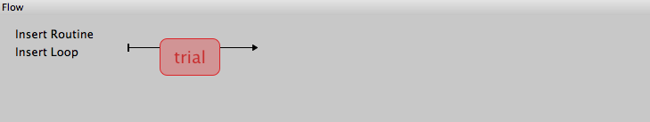
Setup the experiment Flow
Initially the Flow probably looks like this:
We want to have a set of trials for training, followed by some (identical) trials for testing

Slide 17



Add a loop for the training trials
Press Add Loop (single-click)
Select the start and endpoints for the loop (single-click each one)

Slide 18
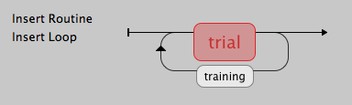
Add your conditions to the loop
Set your number of trials (1 repeat?) and select the file for the conditions (training A or training B, according to your group)
If the loop looks wrong (e.g. in the wrong place) press Undo (or press Ctrl-Z) and repeat the steps. Remember to single-click the buttons

Slide 19
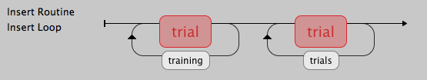
Add main trials
Add another copy of the ‘trial’ Routine at the end of the Flow
Add another loop around it, called trials (or main ?)
use the conditions file ‘testing.xlsx’
nReps = 1
Should look like this:

Slide 20
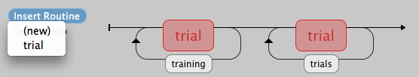
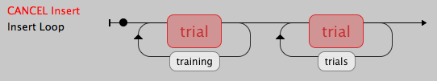
Add some instructions
Press Insert Routine and select (new)
Give your Routine a unique name (‘instr’ ? ) and click where you want it on the Flow

Slide 21
Add some instructions
In your new Routine add a Text Component (called instrText ?) with the text:
Press ‘up’ or ‘down’ keys to identify the stimulus that is a real word
Press any key to continue
Your Text Component should last forever (end time is blank)
Add a Keyboard Component so that you can end the instructions:
ForceEndRoutine should be ticked
allowedKeys should be blank (any key)

Slide 22
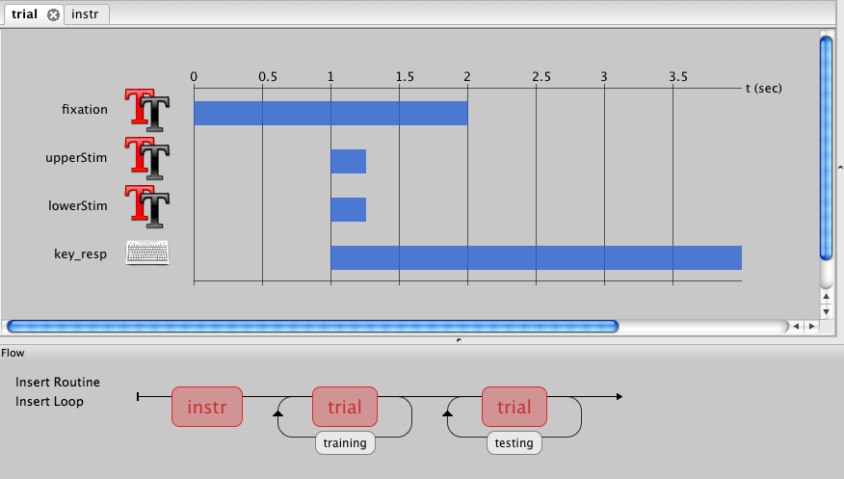
That’s it!

Slide 23
Take a break
We’ll run the study afterwards

